Slide 1
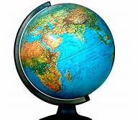
Geography

Slide 2
Objective
In this lesson, students will be able to define or identify the following key words and concepts:
Geography
Five Themes of Geography
The Seven Continents and Five Oceans
Critical Geographic Features and Effects

Slide 3
What is Geography?
Geography is the study of the earth and its geographic features.
Geography is also the study of human life on the earth and the effects of human activity.
Physical geography: think of deserts or mountains; the surface of the earth
Human geography: think how people adapt to a particular environment

Slide 4
Five Themes of Geography
Location – Geographers begin to study a place by finding where it is, or its location.
Place – Geographers study the physical and human features of a location.
Human-Environment Interaction – Geographers study how people affect or shape physical characteristics of their natural surroundings and how does their surroundings (environment) affect them
Movement – Helps explain how people, goods, and ideas get from one place to another.
Regions – Geographers compare the climate, land, population, or history of one place to another.

Slide 5
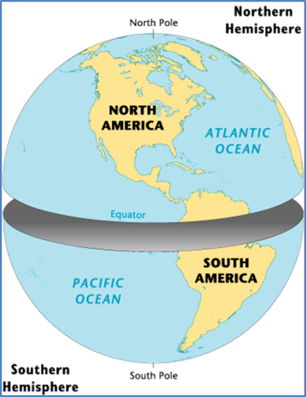
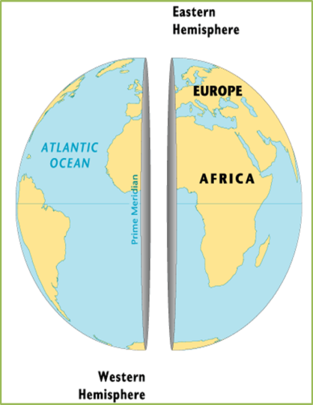
Hemispheres
The earth is divided into hemispheres: Northern, Southern, Eastern and Western.
The equator divides the Northern and Southern Hemisphere.
The Prime Meridian divides the Eastern and Western Hemisphere.

Slide 6
The Continents
A continent is one of the seven principle land masses of the earth.
There are seven continents: Africa, Antarctica, Asia, Australia, Europe, North America and South America.

Slide 7
The Continents
Western Hemisphere: North America, South America and part of Antarctica
Eastern Hemisphere: Asia, Africa, Europe, Australia and part of Antarctica.
Northern Hemisphere: North America, Top of South America, Europe, Asia, and top half of Africa.
Southern Hemisphere: Majority of South America, bottom half of Africa, Australia and Antarctica

Slide 8
Oceans
The words “ocean” refers to the entire body of salt water that covers 70% of the earth’s surface.
As of 2000 there are five Oceans: Atlantic, Arctic, Indian, Pacific and Southern

Slide 9
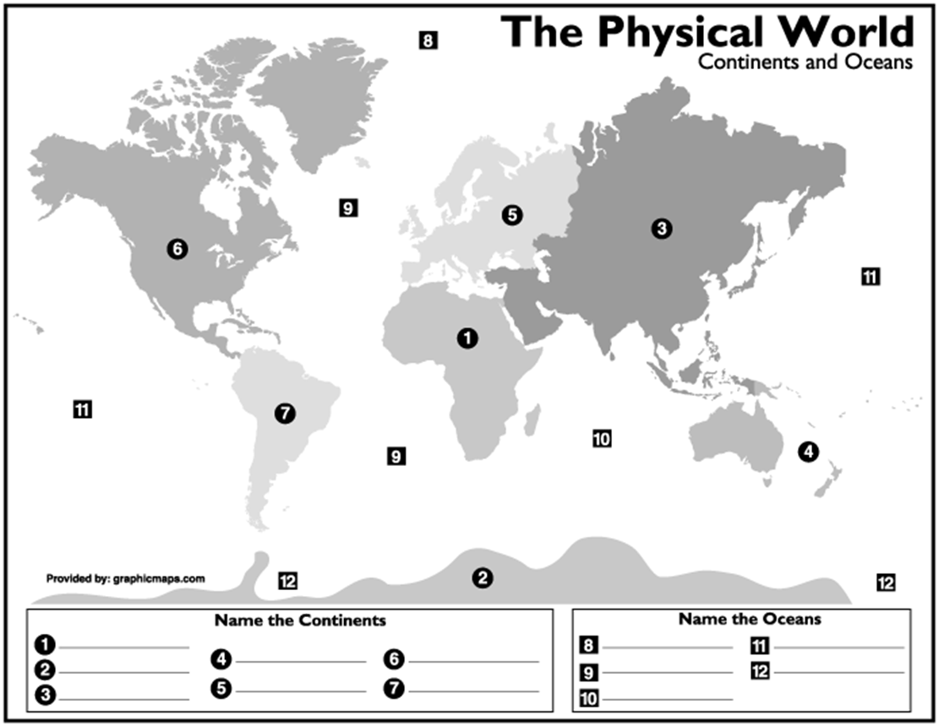
Label the Continents and Oceans

Slide 10
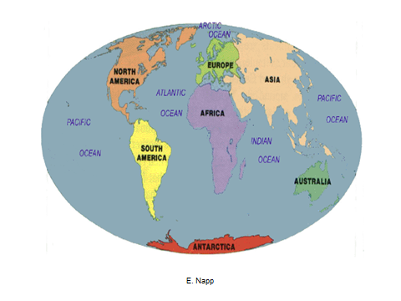
World Map

Slide 11
Geographic Features
Topography is the study of the earth’s surface. It is the study of the earth’s geographic or physical features.
Mountains, deserts, plains, and rivers are examples of geographic or physical features.
It is important to think about the effect of these features on humans.

Slide 12
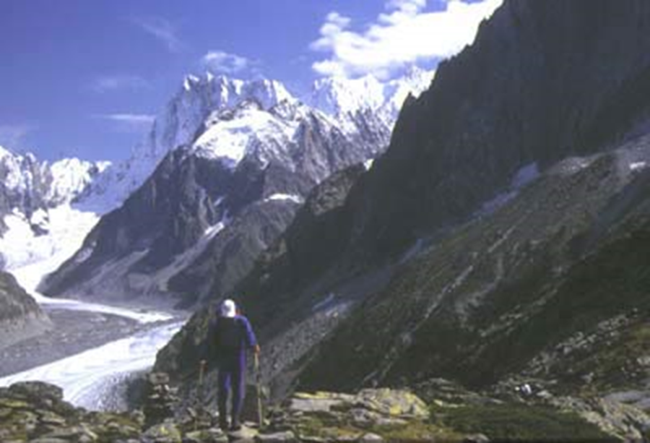
Mountains
A mountain is a natural elevation of the earth’s mass. It generally has steep sides.
It is difficult to farm on mountains.
Mountains can prevent transportation, trade and communication.
Mountains can protect
people from invasions.
Himalayas and Andes

Slide 13
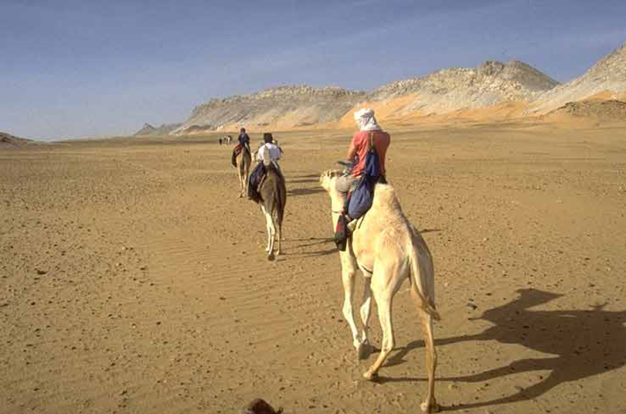
Deserts
A desert is a dry, often sandy region of little rainfall, extreme temperatures and sparse vegetation.
It is difficult to farm in a desert.
Nomads live deserts and move from place to place.

Slide 14
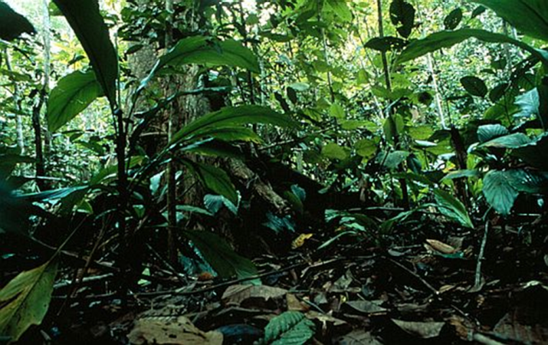
Tropical Rain Forests
A tropical rain forest consists of many trees and plants, has a tropical climate and experiences significant rainfall.
It is difficult to farm.
Slash-and-burn is used to farm
Transportation and
communication are difficult.

Slide 15
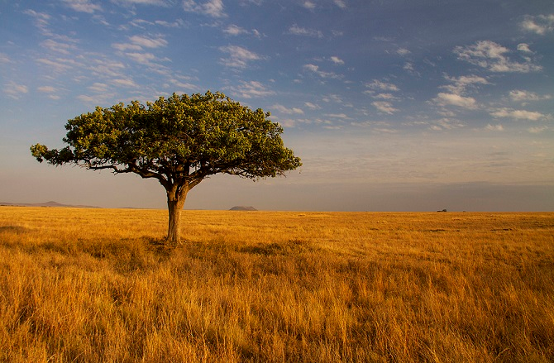
Savannas
A savanna is a flat grassland in a tropical or subtropical region.
People can farm.
People can herd animals.

Slide 16
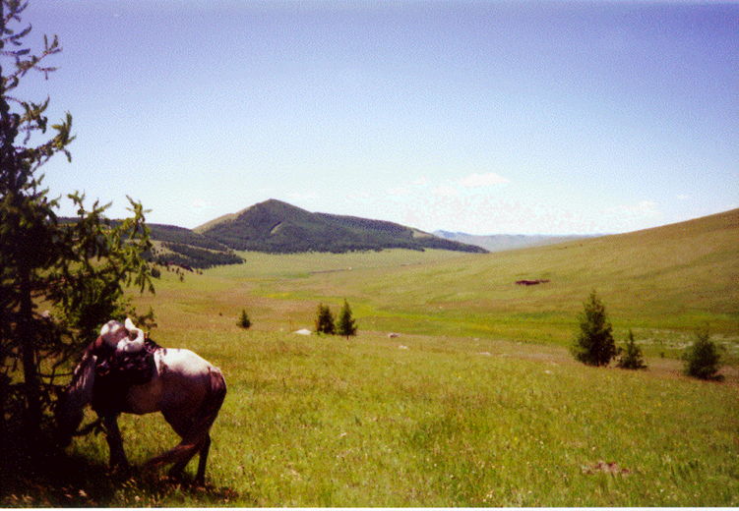
Steppes
A Steppe is a dry, cold, grassland that is found in all of the continents except Australia and Antarctica.
Found usually between the desert and the forest.
Very few people live there.
Horses thrive in the Steppes.

Slide 17
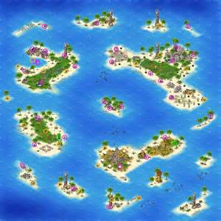
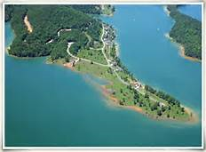
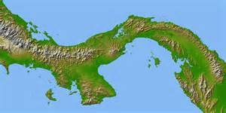
Geographic Landforms
Island is surrounded by water on 4 sides
Archipelago is a chain of islands
Peninsula is surrounded by water on 3 sides and by water on 1 side
Isthmus is a narrow stretch of land that connects 2 larger land masses

Slide 18
Summing it Up
What effect does geography have on a person, society, culture, etc.?

Slide 19
